Slide 1
Advanced CPT (Java)
240-321, Semester 2, 2004-2005
8. GUI Examples II
Chapters 12, 13 (D&D)
Objectives
  describe some of the GUI controls and programming techniques in Java

Slide 2
Contents
1. Reminder on GUI Creation
2. Button Example
3. TextField Examples
4. CheckBoxes Examples
5. RadioButtons Examples
6. Combo Box Example
continued

Slide 3
7. Mouse Motion Example
8. Scroll Pane / Mouse Press
9. Editor Pane Example
10. Other Controls in D&D
11. The SwingSet Examples
12. More Information

Slide 4
1. Reminder on GUI Creation
A reminder of the three steps in writing GUIs:
  1. Declare the GUI controls;
  2. Implement the event handlers for the controls;
  3. Position the controls on the screen by using layout managers and/or containers.

Slide 5
1.1. Emphasis of this Part
The examples in this part will concentrate on controls and event handlers
  steps 1 and 2
The next part (Layout/9) will look at layout managers and containers.

Slide 6
2. Button Example
Features:
  create a JButton object in an application
  an anonymous class implements actionListener
    actionPerformed() is called when the button is pressed
  main() subclasses windowAdapter
    windowClosing() terminates the program

Slide 7

Use
c:> java ButtonTest
Output to the DOS window after three presses:
  Pressed 1
  Pressed 2
  Pressed 3

Slide 8
Event Model
GUI
Press me
int pressCount = 1;
methods
press
event
window
closing
event
actionPerfomed()
anon class
main():
windowClosing()
anon class

Slide 9
Steps in JFrame GUI Creation
The GUI is initialised in the class' constructor method.
Initialisation steps:
  1. get the container for the frame
  2. set the layout manager (FlowLayout)
  3. declare the controls
  4. add them to the container
  5. register the controls with event handlers
  6. set the size of the window, and show it

Slide 10
ButtonTest.java
// The JButton GUI in a Java app
import javax.swing.*;
import java.awt.*;
import java.awt.event.*;
public class ButtonTest extends JFrame
{ int pressCount = 1;
public ButtonTest()
{
super( "Testing JButton" );
Container c = getContentPane();
c.setLayout( new FlowLayout() );
:
step 1
step 2

Slide 11
step 3
// JButton with a string argument
JButton jb = new JButton( "Press me" );
c.add( jb );
// Handle events from pressing the button
jb.addActionListener( new ActionListener() {
public void actionPerformed(ActionEvent e)
{ System.out.println("Pressed " +
pressCount++ ); }
} );
setSize( 200, 100 );
show();
pack(); // shrink the frame
} // end of LabelTest()
step 4
step 5
step 6

Slide 12
public static void main( String args[] )
{
ButtonTest app = new ButtonTest();
app.addWindowListener( new WindowAdapter() {
public void windowClosing( WindowEvent e )
{ System.exit( 0 ); }
} );
} // end of main()
} // end of ButtonTest class

Slide 13
Notes
The 'global' variable pressCount remembers the number of presses between calls to actionPerformed().
The only information passed as an argument to actionPerformed() is the event object e
  other information must be stored globally
pack() causes the frame/applet window to shrink until it fits the controls.

Slide 14
3. TextField Examples
We have two TextField examples:
  TextFieldTest.java
    a Java application
  TextFieldTest2.java and TextFieldTest2.html
    a Java applet and Web page
You should compare them to see the similarities/differences between GUI creation.

Slide 15
3.1. TextField Application
Features:
  create a JTextField object in an application
  (and a JLabel)
  an anonymous class implements actionListener
    actionPerformed() is called when the user types enter in the text field
  main() subclasses windowAdapter
    windowClosing() terminates the program

Slide 16
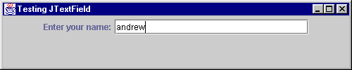
Use
c:> java TextFieldTest
After typing enter, the text disappears from the field, and "You entered andrew" appears in the DOS window.

Slide 17
Event Model
GUI
Enter...:
jtf
methods
type
enter
event
window
closing
event
actionPerfomed()
anon class
main():
windowClosing()
anon class

Slide 18
TextFieldTest.java
// The JTextField GUI in a Java app
import javax.swing.*;
import java.awt.*;
import java.awt.event.*;
public class TextFieldTest extends JFrame
{
JTextField jtf;
// global since used in actionPerformed()
public TextFieldTest()
{
super( "Testing JTextField" );
Container c = getContentPane();
c.setLayout( new FlowLayout() );
:

Slide 19
// label and text entry field
JLabel jl = new JLabel("Enter your name:");
jtf = new JTextField(25); // 25 chs wide
c.add( jl );
c.add( jtf );
// Handle events from pressing return
jtf.addActionListener( new ActionListener() {
public void actionPerformed(ActionEvent e)
{ System.out.println("You entered " +
e.getActionCommand() );
jtf.setText("");
}
} );
setSize( 500, 100 );
show();
} // end of TextFieldTest()

Slide 20
public static void main( String args[] )
{
TextFieldTest app = new TextFieldTest();
app.addWindowListener( new WindowAdapter() {
public void windowClosing( WindowEvent e )
{ System.exit( 0 ); }
} );
} // end of main()
} // end of TextFieldTest class

Slide 21
Notes
The JTextField object, jtf, is global
  this means that actionPerformed() can affect it
  it sets the text to empty ("") after printing a message to stdout
The text inside the text field is accessed through the event object:
  e.getActionCommand()

Slide 22
3.2. TextField Applet
Features:
  create a JTextField object in an applet
  the applet implements actionListener itself
    actionPerformed() is called when the user types enter in the text field
  there is no main(), and no need for a window event handler

Slide 23
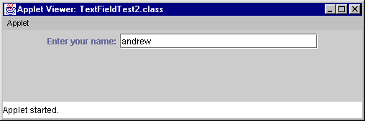
Use
c:> appletviewer TextFieldTest2.html
After typing enter, the text disappears from the field, and "You entered andrew" appears in the DOS window
  same behaviour as the application

Slide 24
Event Model
Enter...:
GUI
jtf
methods
type
enter
event
actionPerformed()

Slide 25
Steps in JApplet GUI Creation
The GUI is initialised in the applet's init() method.
Initialisation steps
  1. get the container for the applet
  2. set the layout manager (FlowLayout)
  3. declare the controls
  4. add them to the container
  5. register the controls with event handlers

Slide 26
TextFieldTest2.java
The applet version
// The JTextField GUI in a Java applet
import javax.swing.*;
import java.awt.*;
import java.awt.event.*;
public class TextFieldTest2 extends JApplet
implements ActionListener
{
JTextField jtf;
// global since used in actionPerformed()
public void init()
{
Container c = getContentPane();
c.setLayout( new FlowLayout() );
:
step 1
step 2

Slide 27
step 3
// label and text entry field
JLabel jl = new JLabel("Enter your name:");
jtf = new JTextField(25); // 25 chs wide
c.add( jl );
c.add( jtf );
jtf.addActionListener(this);
} // end init()
step 4
step 5

Slide 28
// Handle events from pressing return
public void actionPerformed(ActionEvent e)
{
System.out.println("You entered " +
e.getActionCommand() );
jtf.setText("");
}
} // end of TextFieldTest2 class

Slide 29
TextFieldTest2.html
<html>
<body>
<applet code="TextFieldTest2.class"
width="500" height="100">
</applet>
</body>
</html>

Slide 30
Notes
This applet uses another common approach to using event handlers
  the applet implements actionListener itself
  the applet must contain an actionPerformed() method
  the control must be registered with the applet:
    jtf.addActionListener(this);

Slide 31
4. CheckBoxes Example
Features:
  creates 4 JCheckBox objects in an application
  an anonymous class implements actionListener
    actionPerformed() is called when the user presses the "Pepperoni" check box
  an anonymous class implements itemListener
    itemStateChanged() is called when the "Mushroom" box is 'ticked' or 'unticked'

Slide 32
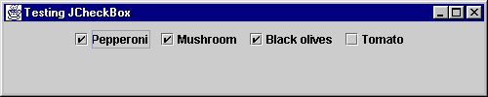
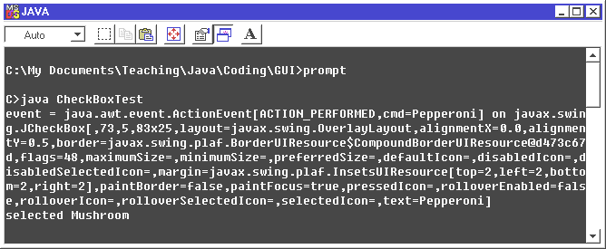
Use
DOS window output:

Slide 33
Event Model
GUI
methods
press
event
actionPerfomed()
window
closing
event
itemStateChanged()
select/
deselect
event
anon classes
main():
windowClosing()

Slide 34
CheckBoxTest.java
// The JCheckBox GUI in a Java app
import javax.swing.*;
import java.awt.*;
import java.awt.event.*;
public class CheckBoxTest extends JFrame
{
public CheckBoxTest()
{
super( "Testing JCheckBox" );
Container c = getContentPane();
c.setLayout( new FlowLayout() );
:

Slide 35
// 4 checkboxes
JCheckBox jck1 = new JCheckBox("Pepperoni");
JCheckBox jck2 = new JCheckBox("Mushroom");
JCheckBox jck3 = new JCheckBox("Black olives");
JCheckBox jck4 = new JCheckBox("Tomato");
c.add( jck1 ); c.add( jck2 );
c.add( jck3 ); c.add( jck4 );
// actionListener for pepperoni box
jck1.addActionListener( new ActionListener() {
public void actionPerformed(ActionEvent e)
{ System.out.println("event = " + e); }
} );
:

Slide 36
// itemListener for mushroom box
jck2.addItemListener( new ItemListener() {
public void itemStateChanged(ItemEvent e)
{ if (e.getStateChange() == e.SELECTED)
System.out.print("selected ");
else System.out.print("de-selected ");
System.out.print("Mushroom\n");
}
} );
setSize( 500, 100 );
show();
} // end of CheckBoxTest()

Slide 37
public static void main( String args[] )
{
CheckBoxTest app = new CheckBoxTest();
app.addWindowListener( new WindowAdapter() {
public void windowClosing( WindowEvent e )
{ System.exit( 0 ); }
} );
} // end of main()
} // end of CheckBoxTest class

Slide 38
Notes
addItemListener() is used to register an ItemListener with a control.
The anonymous class must implement ItemListener's itemStateChanged() method.
itemStateChanged() uses e.getStateChanged() to see if the box was 'ticked' or 'unticked'.
continued

Slide 39
actionPerformed() shows that an event object can be printed
  sometimes useful for debugging

Slide 40
5. RadioButtons Example
Features:
  creates 4 JRadioButton objects in an application
  a separate RadioButtonHandler class implements ItemListener
    itemStateChanged() is called when the user selects/deselects any of the radio buttons
  a ButtonGroup object which forces only one radio button to be 'on' at a time

Slide 41
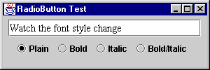
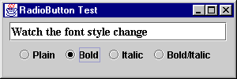
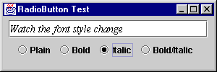
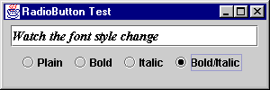
Use

Slide 42
Event Model
Watch the font...
window
closing
event
t
click
methods
main():
windowClosing()
RadioButtonHandler
itemStateChanged(...)
{ // alter t
}

Slide 43
RadioButtonTest.java
Fig.12.12, p.579
import java.awt.*;
import java.awt.event.*;
import javax.swing.*;
public class RadioButtonTest extends JFrame {
private JTextField t;
private Font plainFont, boldFont,
italicFont, boldItalicFont;
private JRadioButton plain, bold,
italic, boldItalic;
:

Slide 44
public RadioButtonTest()
{ super( "RadioButton Test" );
Container c = getContentPane();
c.setLayout( new FlowLayout() );
t = new JTextField(
"Watch the font style change", 25 );
c.add( t );
// Create radio buttons
plain = new JRadioButton( "Plain", true );
c.add( plain );
bold = new JRadioButton( "Bold", false);
c.add( bold );
italic = new JRadioButton( "Italic", false );
c.add( italic );
boldItalic = new JRadioButton(
"Bold/Italic", false );
c.add( boldItalic );
:

Slide 45
// register all controls with 1 handler
RadioButtonHandler handler =
new RadioButtonHandler();
plain.addItemListener( handler );
bold.addItemListener( handler );
italic.addItemListener( handler );
boldItalic.addItemListener( handler );
// create link between JRadioButtons
ButtonGroup radioGroup = new ButtonGroup();
radioGroup.add( plain );
radioGroup.add( bold );
radioGroup.add( italic );
radioGroup.add( boldItalic );
:

Slide 46
plainFont = new Font( "TimesRoman",
Font.PLAIN, 14 );
boldFont = new Font( "TimesRoman",
Font.BOLD, 14 );
italicFont = new Font( "TimesRoman",
Font.ITALIC, 14 );
boldItalicFont = new Font( "TimesRoman",
Font.BOLD + Font.ITALIC, 14 );
t.setFont( plainFont );
setSize( 300, 100 );
show();
} // end of RadioButtonTest()

Slide 47
public static void main( String args[] )
{
RadioButtonTest app = new RadioButtonTest();
app.addWindowListener( new WindowAdapter() {
public void windowClosing( WindowEvent e )
{ System.exit( 0 ); }
} );
} // end of main()

Slide 48
private class RadioButtonHandler
implements ItemListener {
public void itemStateChanged( ItemEvent e )
{
if ( e.getSource() == plain )
t.setFont( plainFont );
else if ( e.getSource() == bold )
t.setFont( boldFont );
else if ( e.getSource() == italic )
t.setFont( italicFont );
else if ( e.getSource() == boldItalic )
t.setFont( boldItalicFont );
t.repaint();
}
} // end of RadioButtonHandler class
} // end of RadioButtonTest class

Slide 49
Notes
This example shows the third main way of implementing event handlers:
  as a separate class which implements the event listener class
  RadioButtonHandler implements ItemListener
The other two approaches:
  an anonymous class in the program
  have the program implement the event listener
continued

Slide 50
One tricky aspect of this approach is the visibility of variables:
  i.e. itemStateChanged() in RadioButtonHandler must be able to affect the text field t in RadioButtonTest, and examine/use its radio buttons and fonts
D&D's solution is to declare RadioButtonHandler inside RadioButtonTest, which allows it to see all the globals, even though they are private.
continued

Slide 51
This example shows that several controls can have the same event handler
  all 4 buttons use a single RadioButtonHandler object
The ButtonGroup object is not visible on the screen.

Slide 52
6. Combo Box Example
Features:
  creates a JComboBox object in an application
  (a combo box is a drop-down list)
  the selection updates an icon inside a label
  an anonymous class implements itemListener
    itemStateChanged() is called when the user clicks on one of the items on the list

Slide 53
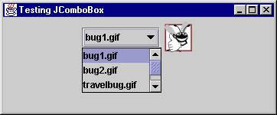
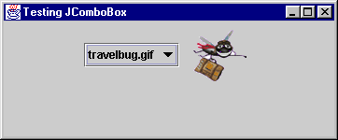
Use
select
travelbug.gif

Slide 54

Event Model
methods
window
closing
event
itemStateChanged()
select
item
event
anon class
main():
windowClosing()

Slide 55
ComboBoxTest.java
Fig.12.13, p.581
// Using a JComboBox to select an image
import java.awt.*;
import java.awt.event.*;
import javax.swing.*;
public class ComboBoxTest extends JFrame {
private JComboBox images;
private JLabel label;
private String names[] =
{ "bug1.gif", "bug2.gif",
"travelbug.gif", "buganim.gif" };
private Icon icons[] =
{ new ImageIcon( names[ 0 ] ),
new ImageIcon( names[ 1 ] ),
new ImageIcon( names[ 2 ] ),
new ImageIcon( names[ 3 ] ) };
:

Slide 56
public ComboBoxTest()
{
super( "Testing JComboBox" );
Container c = getContentPane();
c.setLayout( new FlowLayout() );
// initialise the combo box
images = new JComboBox( names );
images.setMaximumRowCount( 3 );
images.addItemListener( new ItemListener() {
public void itemStateChanged( ItemEvent e )
{ label.setIcon(
icons[ images.getSelectedIndex() ] );
} }
);
:

Slide 57
c.add( images );
label = new JLabel( icons[ 0 ] );
c.add( label );
setSize( 350, 100 );
show();
} // end of ComboBoxTest()
public static void main( String args[] )
{
ComboBoxTest app = new ComboBoxTest();
app.addWindowListener( new WindowAdapter() {
public void windowClosing( WindowEvent e )
{ System.exit( 0 ); }
} );
}
} // end of ComboBoxTest

Slide 58
Notes
itemStateChanged() does not use the e event object; it checks the images combo box
  images.getSelectedIndex()
  returns the index of the item selected
The icon filenames are stored in an icon[]array, and used to update the label:
  label.setIcon( icon[...])

Slide 59
7. Mouse Motion Example
Features:
  a simple paint program for drawing into a JPanel which is placed inside the JFrame
  an anonymous class implements MouseMotionAdapter
    mouseDragged() is called when the user presses and drags the mouse
    the current cursor position is used to draw a circle (a dot)

Slide 60
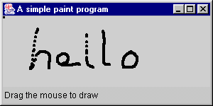
Use

Slide 61
Event Model
window closing
event set to mean exit
label
methods
PaintPanel
class
mouseDragged()
drag the
mouse
event
anon class

Slide 62
Painter.java
/* This program draws black dots into a panel.
The coding works but is too simple in some
cases.
*/
import javax.swing.*;
import java.awt.event.*;
import java.awt.*;
:

Slide 63
public class Painter extends JFrame {
public Painter()
{ super( "A simple paint program" );
Container c = getContentPane();
c.add( new PaintPanel(), "Center");
c.add( new Label("Drag the mouse to draw" ),
BorderLayout.SOUTH );
setDefaultCloseOperation(
JFrame.EXIT_ON_CLOSE);
setSize( 300, 150 );
show();
}
public static void main( String args[] )
{ new Painter(); }
} // end of Painter

Slide 64
class PaintPanel extends JPanel
{ private int xCoord = -1;
private int yCoord = -1;
public PaintPanel()
{
addMouseMotionListener( new MouseMotionAdapter() {
public void mouseDragged( MouseEvent e)
{ xCoord = e.getX(); yCoord = e.getY();
// System.out.println( xCoord + ", " + yCoord );
repaint();
}
} );
} // end of PaintPanel()
:

Slide 65
public void paintComponent(Graphics g)
{
g.fillOval( xCoord, yCoord, 4, 4 );
}
} // end of PaintPanel

Slide 66
Notes
This is our first ‘graphics’ example
  the modern approach is to use a JPanel as a drawing area (a canvas)
  this is not the approach used in the Painter.java example in D&D
The JPanel is subclassed and added to the JFrame using a BorderLayout
  layouts will be explained in part 9
continued

Slide 67
A JPanel is painted by the JVM calling its paintComponent() method
  we override that method, not paint()
paintComponent() is called whenever the JVM needs to repaint the JPanel

Slide 68
PaintPanel Notes
mouseDragged() updates two global variables (xValue and yValue), based on the cursor's position:
  xValue = e.getX(); yValue = e.getY();
mouseDragged() finishes by calling repaint(), which makes the JVM call paintComponent(), which draws a circle using the x,y coordinates.
continued

Slide 69
Dragging generates many mouseDragged events
  Java tries its best to process each one
  but if the OS is too slow, then Java drops some events
  that is why there are gaps between the dots
continued

Slide 70
Swing uses a different drawing technique from AWT which means that all the ovals stay on screen
  in AWT, the repaint() call would delete the previous dots when drawing a new one
  this will be explained more in the ‘Graphics’ part of the notes

Slide 71
Problems with this Code
The program works as expected, so long as it is not hidden by another window, and then shown again.
When the JPanel is redrawn, the drawing area may be ‘scrambled’
  dots may be drawn in the wrong place, extra dots may appear, etc.
continued

Slide 72
The solution is a more complicated data structure in the program that 'remembers' the old dots so they can all be redrawn correctly by paintComponent() when necessary.
We will do that in the 'Graphics' part of the notes.

Slide 73
8. Scroll Pane / Mouse Press
Features:
  a subclass of JPanel (BMWPanel) which loads an image and listens for mouse clicks over the image;
  the position of a click is sent to stdout;
  BMWPanel is loaded into a scroll pane;
  the scroll pane has a preferred size less than the image

Slide 74
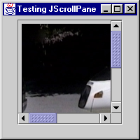
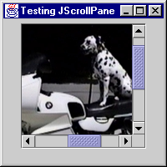
Use
scroll across
and down

Slide 75
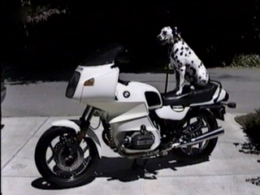
Event Model
uses
mouse
press
event
150
window
closing
event
150
methods
methods
main():
mousePressed()
windowClosing()
ScrollPaneTest
BMWPanel

Slide 76
ScrollPaneTest.java
// The JScrollPane GUI in a Java app
import javax.swing.*;
import java.awt.*;
import java.awt.event.*;
public class ScrollPaneTest extends JFrame
{
public ScrollPaneTest()
{
super( "Testing JScrollPane" );
Container c = getContentPane();
c.setLayout( new FlowLayout() );
:

Slide 77
// BMW panel creation
BMWPanel bp = new BMWPanel();
// Place the panel inside a scrollPane
JScrollPane jsp = new JScrollPane( bp );
jsp.setPreferredSize(
new Dimension(150, 150) );
c.add( jsp );
setSize( 200, 200 );
show();
} // end of ScrollPaneTest()

Slide 78
public static void main( String args[] )
{
ScrollPaneTest app = new ScrollPaneTest();
app.addWindowListener( new WindowAdapter() {
public void windowClosing( WindowEvent e )
{ System.exit( 0 ); }
} );
} // end of main()
} // end of ScrollPaneTest class

Slide 79
class BMWPanel extends JPanel
// Contains a picture of a BMW and listens for
// mouse clicks. It prints the location to stdout
{
public BMWPanel()
{ JLabel jl = new JLabel(
new ImageIcon( "bmw.jpg" ));
add(jl);
addMouseListener( new MouseAdapter() {
public void mousePressed( MouseEvent e)
{ System.out.println( e.getX() + ", "
+ e.getY() ); }
} );
} // end of BMWPanel()
} // end of BMWPanel class

Slide 80
Notes
The scroll pane's preferred size is independent of the frame's size (set with setSize())
BMWPanel does not need to call show(), since it is being used by the frame.
continued

Slide 81
JPanel in Swing is used in two main ways:
  as a canvas for images (as in the Painter example)
  as a container for grouping controls (as here)
JPanel replaces AWT's Canvas and Panel classes.
Since JPanel is a container, the label, jl, can be added to it without calling getContentPane() first.

Slide 82
9. Editor Pane Example
Features:
  use an JEditorPane object to display formatted HTML text loaded from a local file
  the JEditorPane object is inside a scroll pane so that it can be made a reasonable size on-screen

Slide 83
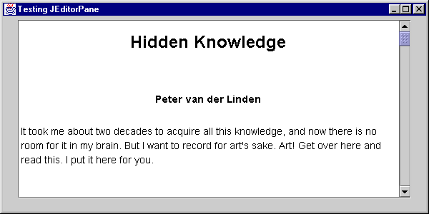
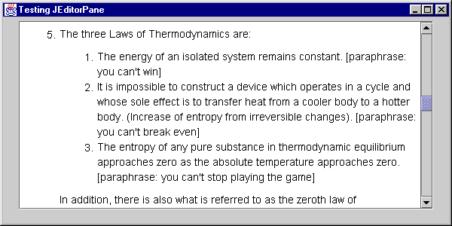
Use
scroll
down

Slide 84
Event Model
JEditorPane
window
closing
event
methods
main():
windowClosing()

Slide 85
EditorPaneTest.java
// The JEditorPane GUI in a Java app
import javax.swing.*;
import java.awt.*;
import java.awt.event.*;
public class EditorPaneTest extends JFrame
{
public EditorPaneTest()
{
super( "Testing JEditorPane" );
Container c = getContentPane();
c.setLayout( new FlowLayout() );
:

Slide 86
// editorPane creation
JEditorPane jep = null;
try {
jep = new JEditorPane(
"file:///windows/desktop/know.html");
}
catch (Exception e) {
System.out.println("error: "+e);
System.exit(0);
}
jep.setEditable(false);
:

Slide 87
// place in scrollPane
JScrollPane jsp = new JScrollPane( jep );
jsp.setPreferredSize(
new Dimension(550, 250));
c.add( jsp );
setSize( 600, 300 );
show();
} // end of EditorPaneTest()

Slide 88
public static void main( String args[] )
{
EditorPaneTest app = new EditorPaneTest();
app.addWindowListener( new WindowAdapter() {
public void windowClosing( WindowEvent e )
{ System.exit( 0 ); }
} );
} // end of main()
} // end of EditorPaneTest class

Slide 89
Notes
The scroll pane's preferred size is wide enough (550 x 250) to only require a scroll bar along the vertical.
The editor pane is displaying a local file:
  "file:///windows/desktop/know.html"
On windows, this means:
  c:\windows\desktop\know.html
continued

Slide 90
JEditorPane can also display Rich Text Format (RTF) and Unicode characters.
When combined with networking classes, JEditorPane can be used as the basis of a Web browser, complete with hypertext links!!
  see my "Client/Server Distributed Programming" subject

Slide 91
10. Other Controls in D&D
Several other controls are described in D&D:
  JPasswordField, JList, JSlider
  JMenus, JPopUpMenus
  JDesktopPane, JInternalFrame

Slide 92
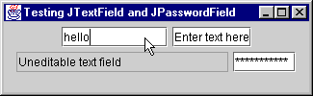
JPasswordField Sec. 12.5, p.566

Slide 93
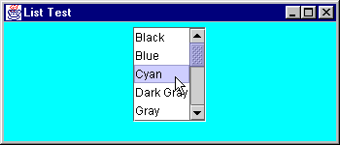
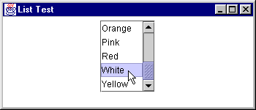
JList Sec.12.9, p.584

Slide 94
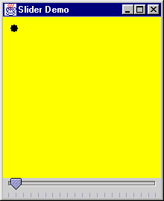
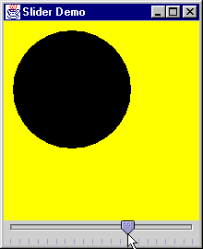
JSlider Sec. 13.5, p.639
this is the slider

Slide 95
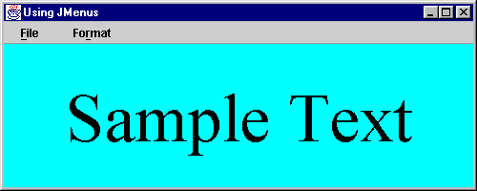
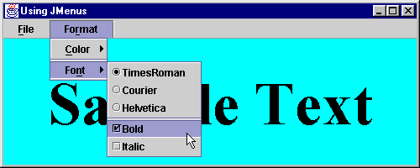
JMenus Sec.13.8, p.650

Slide 96
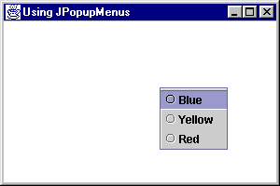
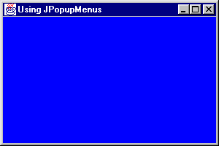
JPopupMenus Sec.13.9, p.658
the menu appears when the right mouse
button is pressed on Windows

Slide 97
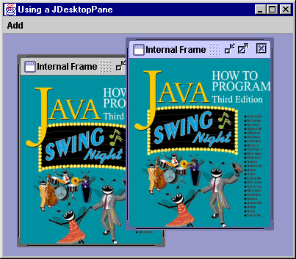
JDesktopPane and JInternalFrame
Sec. 13.11, p.665
minimize
maximize
close
resizing/
movement
via frame
edges

Slide 98
11. The SwingSet Examples
The JDK comes with excellent examples, complete with source code.
The Swing examples are found in:
  c:\j2sdk1.4.2\demo\jfc\SwingSet2
The source code is in:
  c:\j2sdk1.4.2\demo\jfc\SwingSet2\src
continued

Slide 99
The examples are run by executing a JAR file:
  c:> java -jar SwingSet2.jar
A JAR file is very similar to a zipped file:
  a compressed file containing various Java resources (e.g. compiled code, images)
  a good way to distribute finished programs

Slide 100
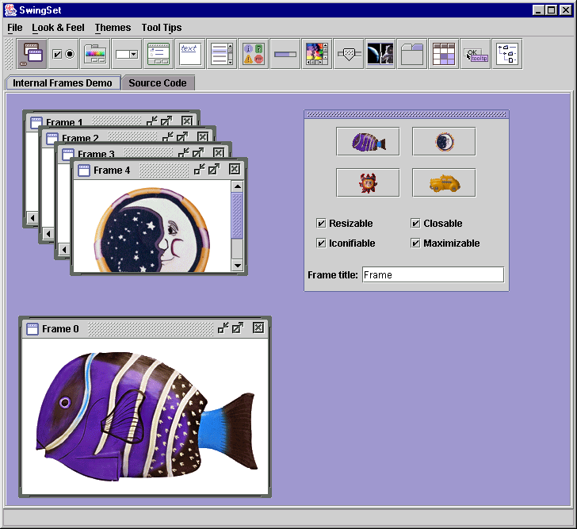
SwingSet2 Start-up Screen

Slide 101
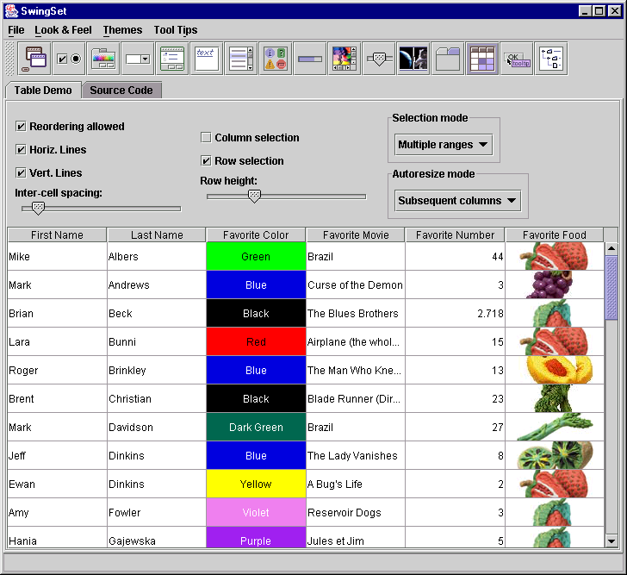
JTable

Slide 102
12. More Information
Weighing in at 1621 pages!!:
  Graphic Java 2: Mastering the JFC
  Volume 2: Swing
  David M. Geary
  Sun MicroSystems, 1999, 3rd edition
The other volumes:
  AWT (vol. 1), Advanced Swing (vol. 3)
  Java 2D (vol. 4)
We have two
copies in our
library.
continued

Slide 103
The Java tutorial "Creating a GUI with JFC/Swing".
Sub-topics include:
  Getting Started with Swing
  Swing Features and Concepts
  Using Swing Components
  Using Other Swing Features
  Laying Out Components Within a Container
  Writing Event Listeners
  Working with Graphics
Excellent

